Slide 1
Linux Hardening
By RJ

Slide 2
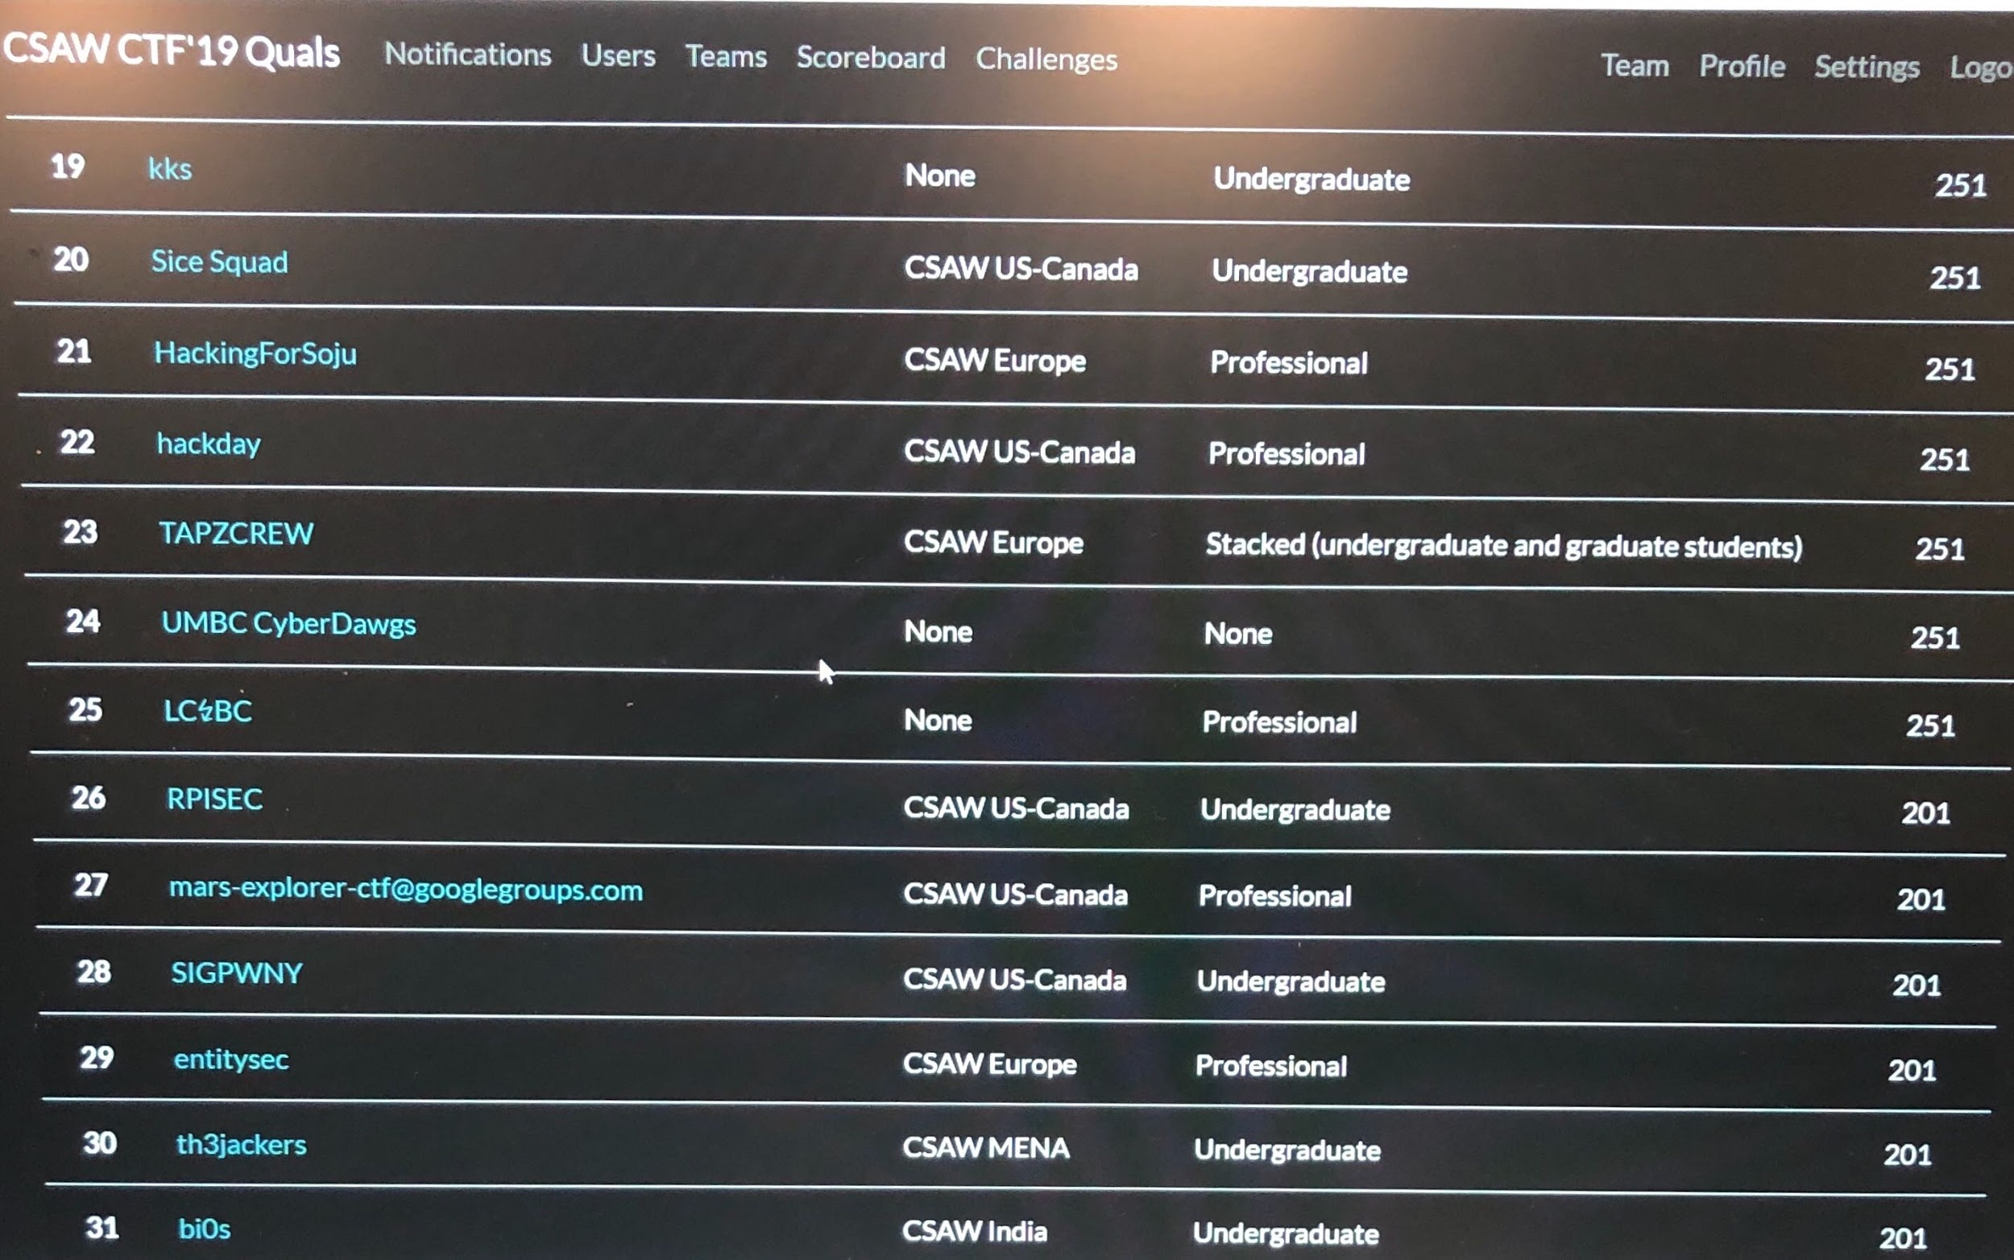

Slide 3
Users, Groups, and Permissions

Slide 4
Principle of Least Privilege
A user should have the minimum amount of privilege required for completing their activities
If an unprivileged account is compromised, attackers can’t do much with it
Create users and groups with permissions for specific purposes

Slide 5
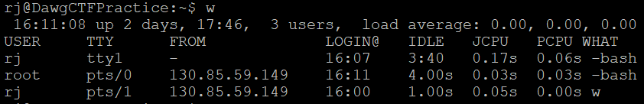
Listing Users
w command shows lots of info about who is logged in
TTY - Terminal given to directly connected user
PTS - Terminal given to remotely connected user (i.e. ssh or telnet)

Slide 6
/etc/passwd, /etc/group, /etc/shadow
/etc/passwd stores info about each user
UID, GID, home dir, shell
/bin/false vs /usr/sbin/nologin
/etc/group stores info about each group
GID and users who belong to the group
/etc/shadow stores password hashes
Hash type, salt, password hash

Slide 7
/etc/sudoers
Specifies who can run commands that require root privileges
Format: user (host)=(user:group) commands

Slide 8
Linux Permissions
Owner can read, write, and execute
Members in owner’s group can read and write
All other users can read

Slide 9
Changing owner, group, and permissions
chown [user] [path]
chgrp [group] [path]
chmod [permissions] [path]

Slide 10
Attack Surface

Slide 11
Attack Surface
Attack surface: combination of all methods an attacker could use to gain access to a system
Need to be aware of what services services are running on a system and how to secure them
Need to know what is coming in and out of network

Slide 12
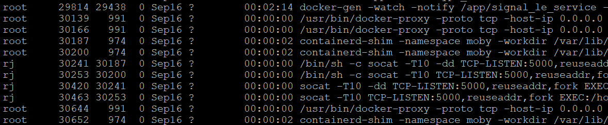
Listing Processes
ps -ef | less -S

Slide 13
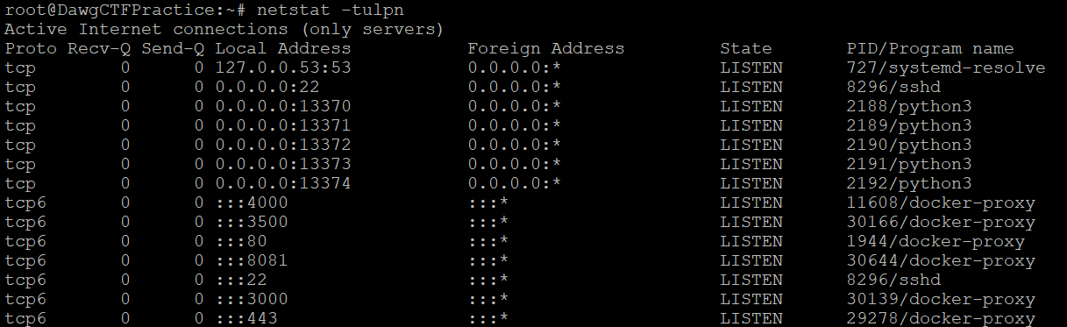
Listing Listening Network Connections
netstat -tulpn

Slide 14
Hardening Services
Services in Linux are highly configurable
Often come with a configuration file
Usually many security configuration options available - research them and configure the service properly
Usually can just google “securing whatever service” and someone’s written a guide about it

Slide 15
Patching Service Vulnerabilities
Check for out of date services and make sure you are running the latest version!
Research CVEs for services and apply appropriate mitigations

Slide 16
Firewall Rules
Will go into this in much more depth in a couple weeks
Can set rules on what traffic is allowed in and out of a computer or network
Show firewall rules using iptables -nvL

Slide 17
SSH
Protocol for remotely accessing a Linux system
Pay very close attention to how SSH is configured!
/etc/ssh/sshd_config

Slide 18
History and Logging
Bash history of a user is stored in .bash_history file in their home directory
Logs are stored in /var/log
/var/log/auth.log shows all authentication attempts
Services often have their own log files

